Slide 1
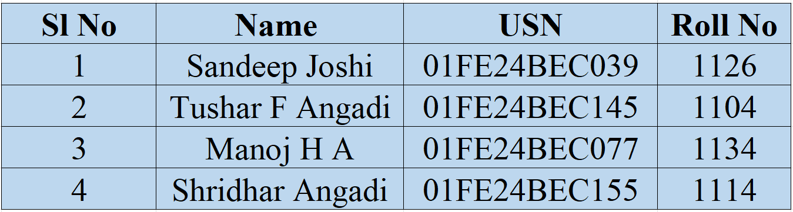
IoT based project
TEAM MEMBERS:

Slide 2
IOT based Air Quality Index Monitoring
NEED STATEMENT

Slide 3
PROBLEM DEFINITON:
Air quality is known to have significant health impacts, but there is a lack of systems that connect real-time AQI data with public health records or disease monitoring systems.
Industrial zones are major contributors to air pollution, but real-time monitoring in these areas is often insufficient.

Slide 4
Air pollution is one of the biggest challenges that the world is facing today as it has got adverse effects on human health like lung cancer, respiratory and heart diseases. There is a need to constantly measure, analyze and monitor the air quality on a real-time basis so that appropriate measures can be taken whenever needed.
Motivation:

Slide 5
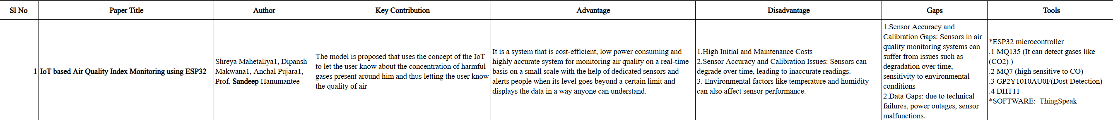
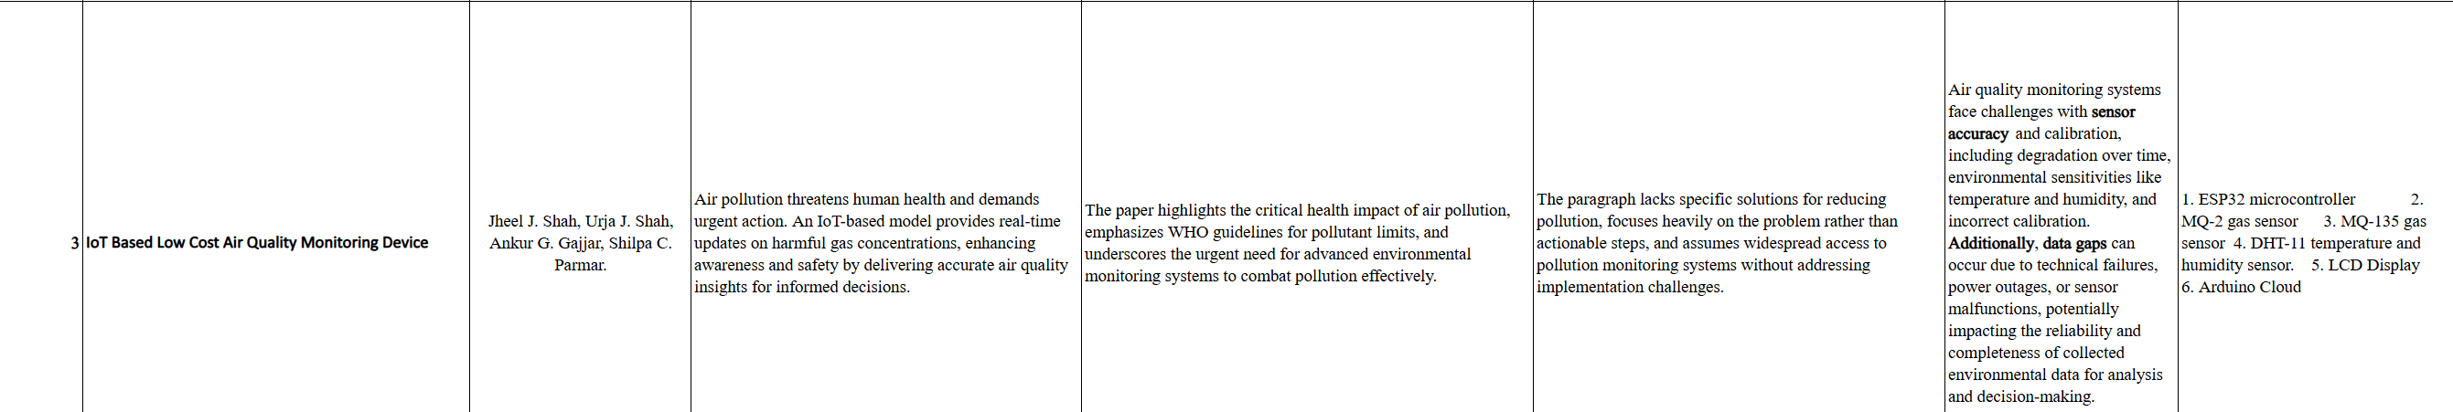
DESIGN AND DEVELOPMENT TABLE:

Slide 6
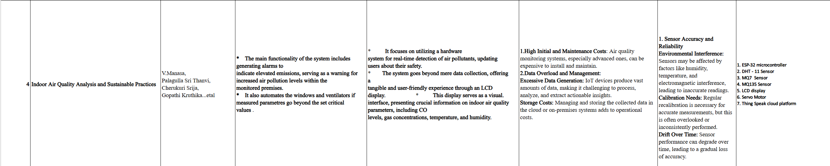

Slide 7
METHODOLOGY - IV :
Indoor Air Quality Analysis and Sustainable Practices
The main functionality of the system includes generating alarms to
indicate elevated emissions, serving as a warning for increased air pollution levels within the
monitored premises.
It also automates the windows and ventilators if measured parameters go beyond the set critical values .

Slide 8
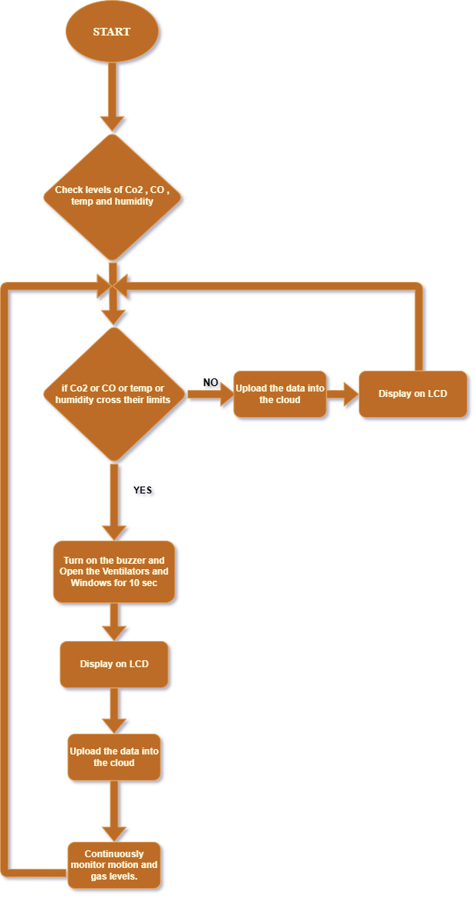
FLOWCHART

Slide 9
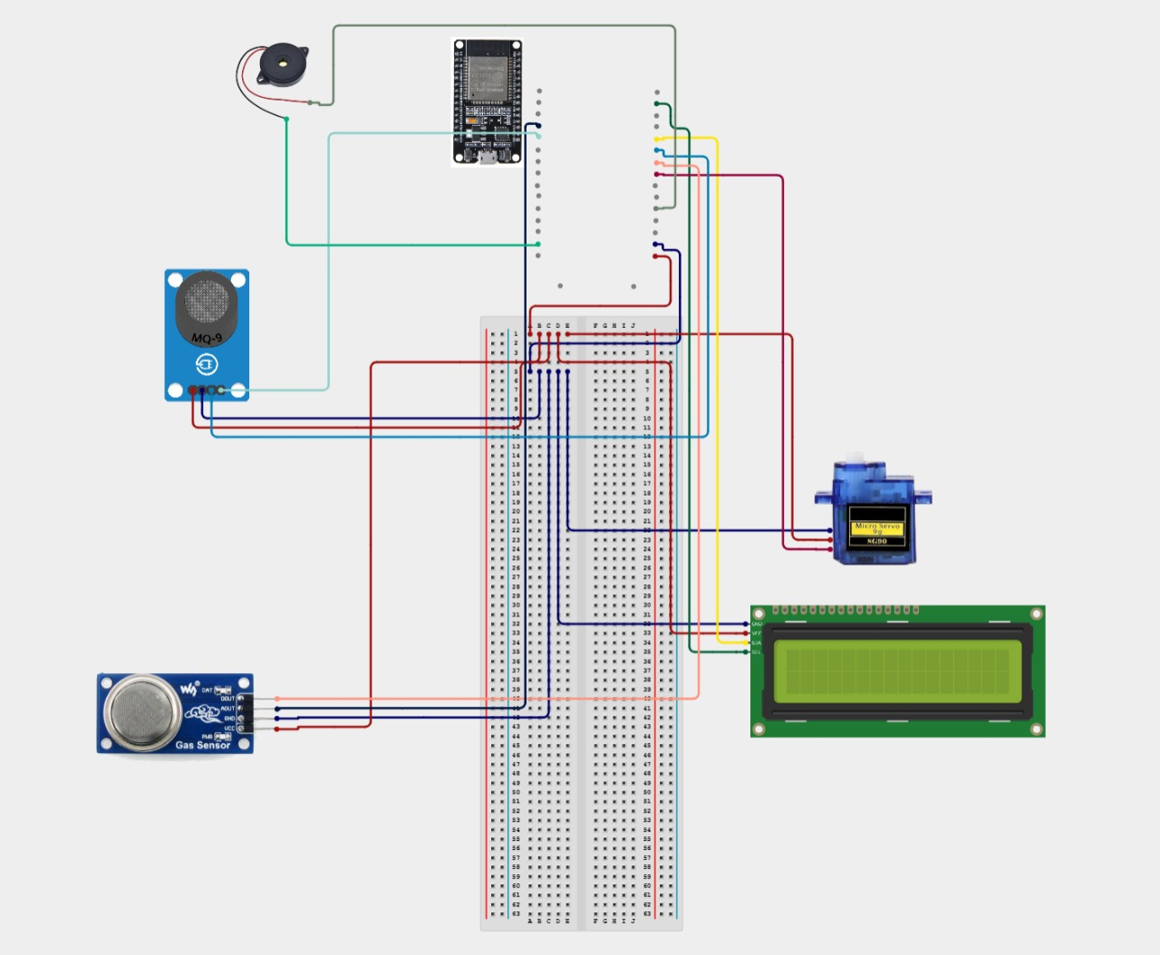
CIRCUIT DIAGRAM

Slide 10
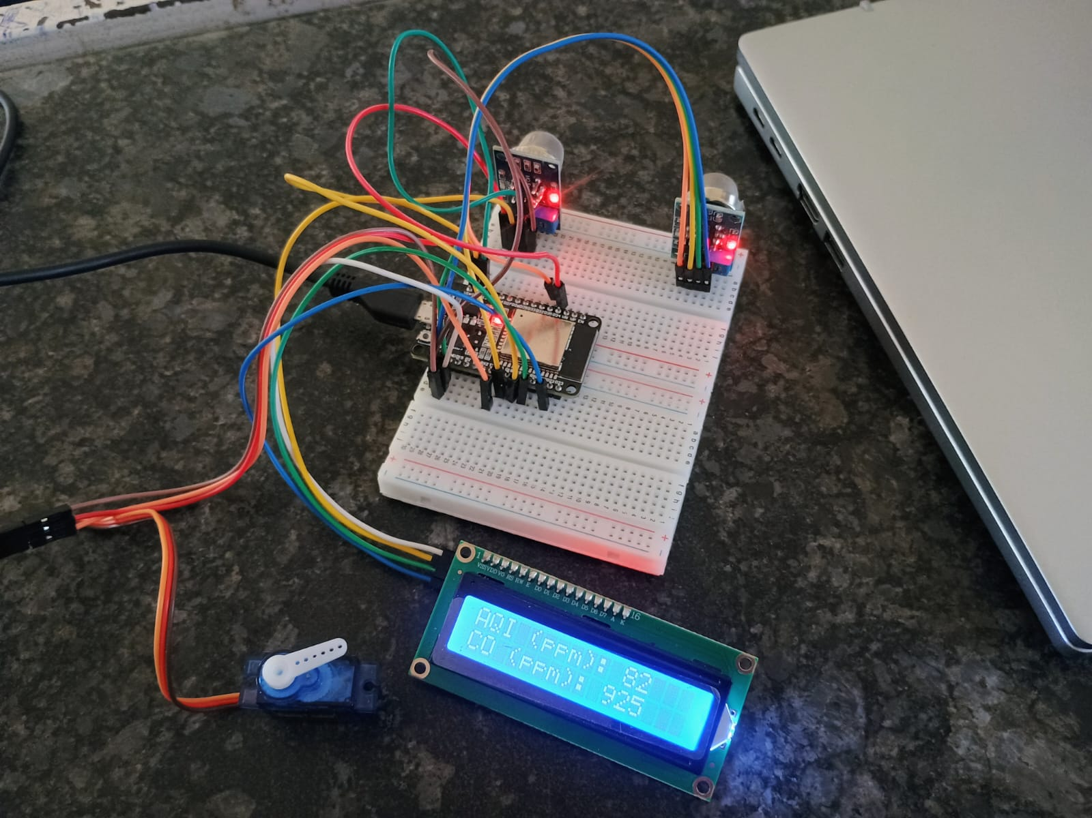
PROTOTYPE PHOTO

Slide 11
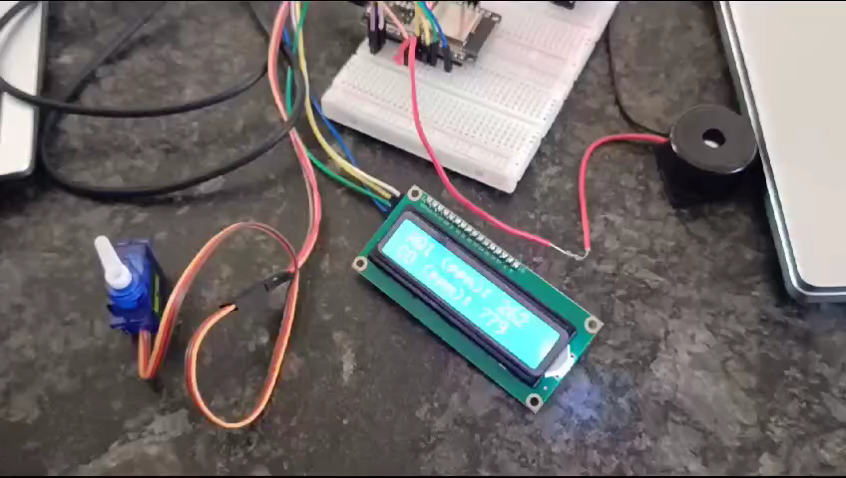
WORKING PROTOTYPE VIDEO

Slide 12
excel sheet Link: https://onedrive.live.com/personal/e856575fac8b4ed6/_layouts/15/Doc.aspx?sourcedoc=%7Bcf139b0f-84c6-437f-a4f8-36b9a784f9a5%7D&action=default&redeem=aHR0cHM6Ly8xZHJ2Lm1zL3gvYy9lODU2NTc1ZmFjOGI0ZWQ2L0VRLWJFOF9HaEg5RHBQZzJ1YWVFLWFVQjV3cTNXbVZWV0VzX0xVakYzbjczLUE_ZT1XOHRucg&slrid=3ea471a1-80a7-4000-45cb-6b70cdbc340d&originalPath=aHR0cHM6Ly8xZHJ2Lm1zL3gvYy9lODU2NTc1ZmFjOGI0ZWQ2L0VRLWJFOF9HaEg5RHBQZzJ1YWVFLWFVQjV3cTNXbVZWV0VzX0xVakYzbjczLUE_cnRpbWU9QTFhdUUzSW0zVWc&CID=e6e72fe6-bff0-4e46-af17-3844c5b3d472&_SRM=0:G:37
THANK YOU

